Slide 1
How to Get a Residence Permit?
IN TURKEY

Slide 2
Residence Permit
If you want to live and/or work in Turkey, you have to get a residence permit within one month

Slide 3
Residence Permit
For long-term residence in Turkey, the applicant should submit the following documents to the local Police Department:

Slide 4
Residence Permit
4 passport-size photos
Passport
Photocopies of the following pages of the
passport: the page bearing the applicant’s
photo, the page stamped at the last entry, the page
indicating the validity and expiry dates of the
passport
A bank statement or a currency exchange slip
testifying to an asset in the amount of USD 300 for
each month

Slide 5
Residence Permit
Documents required to apply for a residence permit for work purposes:
4 passport-size photos
Passport
Photocopies of the following pages of the passport: the page bearing the applicant’s photo, the page stamped at the last entry, the page indicating the validity and expiry dates of the passport
The original and a copy of the work permit issued by the Ministry of
Labor and Social Security

Slide 6
How to Get a Work Permit?
IN TURKEY

Slide 7
Work Permit
Obtaining a Work Permit in Turkey
Applications for work permits can be made inside or outside Turkey:
Foreigners residing outside Turkey shall apply to the relevant Turkish Consulate of either his/her country of residence or his/her country of citizenship.
Foreigners with a valid residence permit (valid for a minimum of 6 months, except for residence permits for educational purposes) can apply directly to the Ministry of Labor and Social Security.

Slide 8
Work Permit
Foreigners applying for a work permit from their country of residence

Slide 9
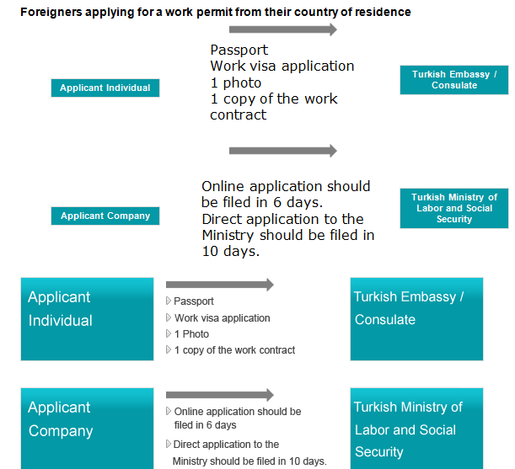
Work Permit

Slide 10
Work Permit
If all documents submitted are accurate and complete, the issuing process will take around 30 days.
Once approved, the applicant is informed by phone or e-mail.
Foreign nationals need an authorized Turkish citizen with a power of attorney to handle their electronic application as the process requires a Turkish national identification number.

Slide 11
Work Permit
Once the work permit has been issued and the work visa application has been approved by the Ministry of Labor and Social Security:
Non-refundable work visa processing fee
Non-refundable work permit processing fee
To obtain a residence permit, work visa and work permit holders must apply to the Alien’s Branch of the Local Police Department (Emniyet Mudurlugu Yabancilar Subesi) within 30 days following their arrival in Turkey.

Slide 12
Work Permit
Foreigners applying for a work permit in Turkey
Foreigners with a valid residence permit that is valid for a minimum of 6 months, except for residence permits for educational purposes, can apply directly to the Ministry of Labor and Social Security.

